Slide 1
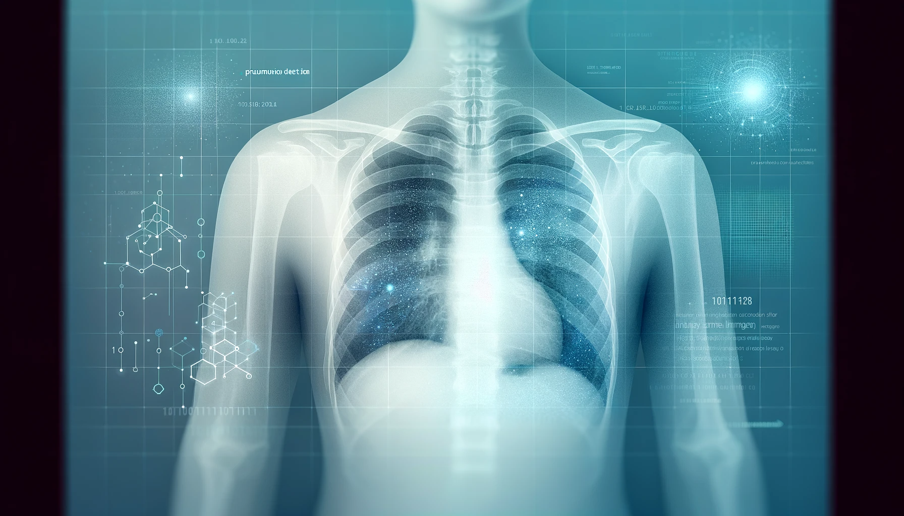
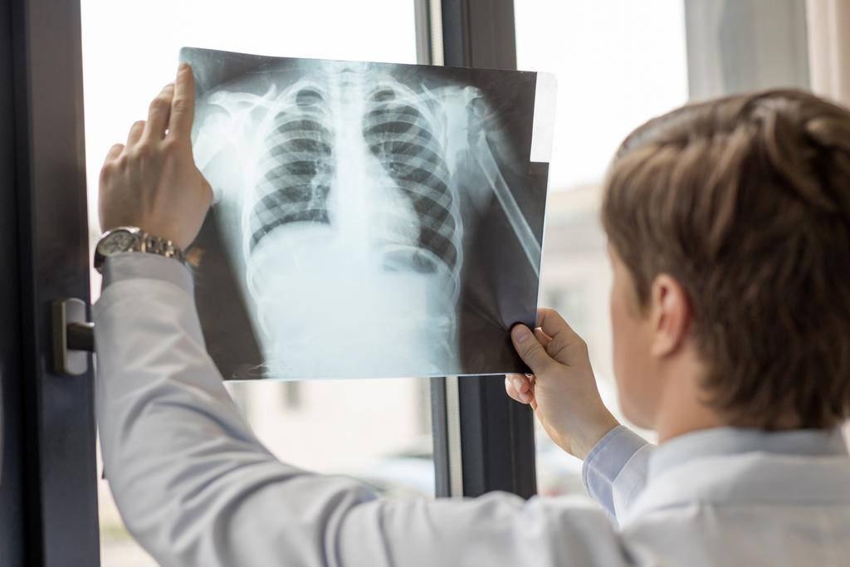
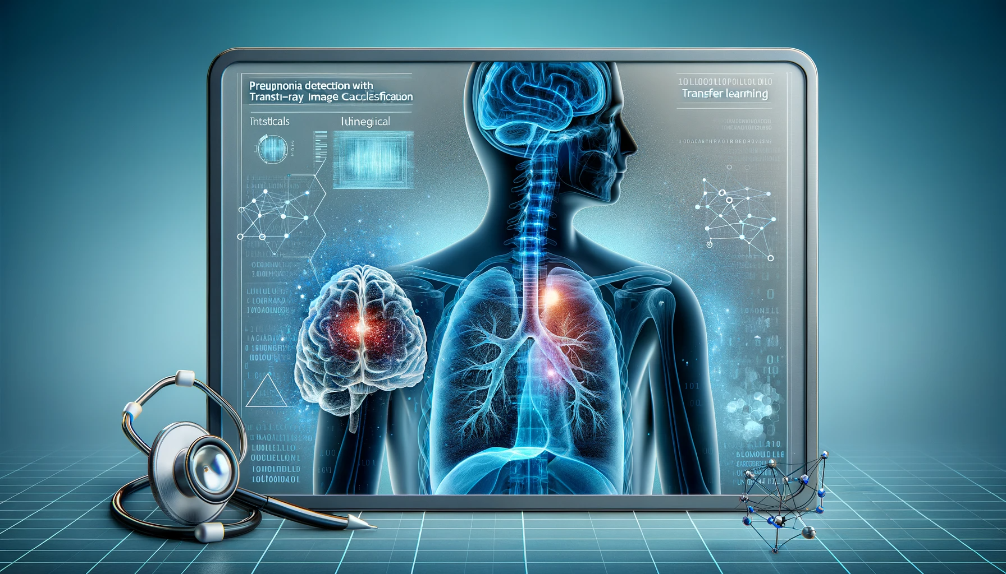
Created by: Muhammad Ameer Hamza
Student ID: 22034204
Colab Notebook Link: PneumoNet:_Chest_X-Ray_Analysis_Using_Transfer_Learning.ipynb
GitHub Repo Link: Transfer-Learning-Assignment
Pneumonia Detection with Transfer Learning: Chest X-Ray Image Classification

Slide 2
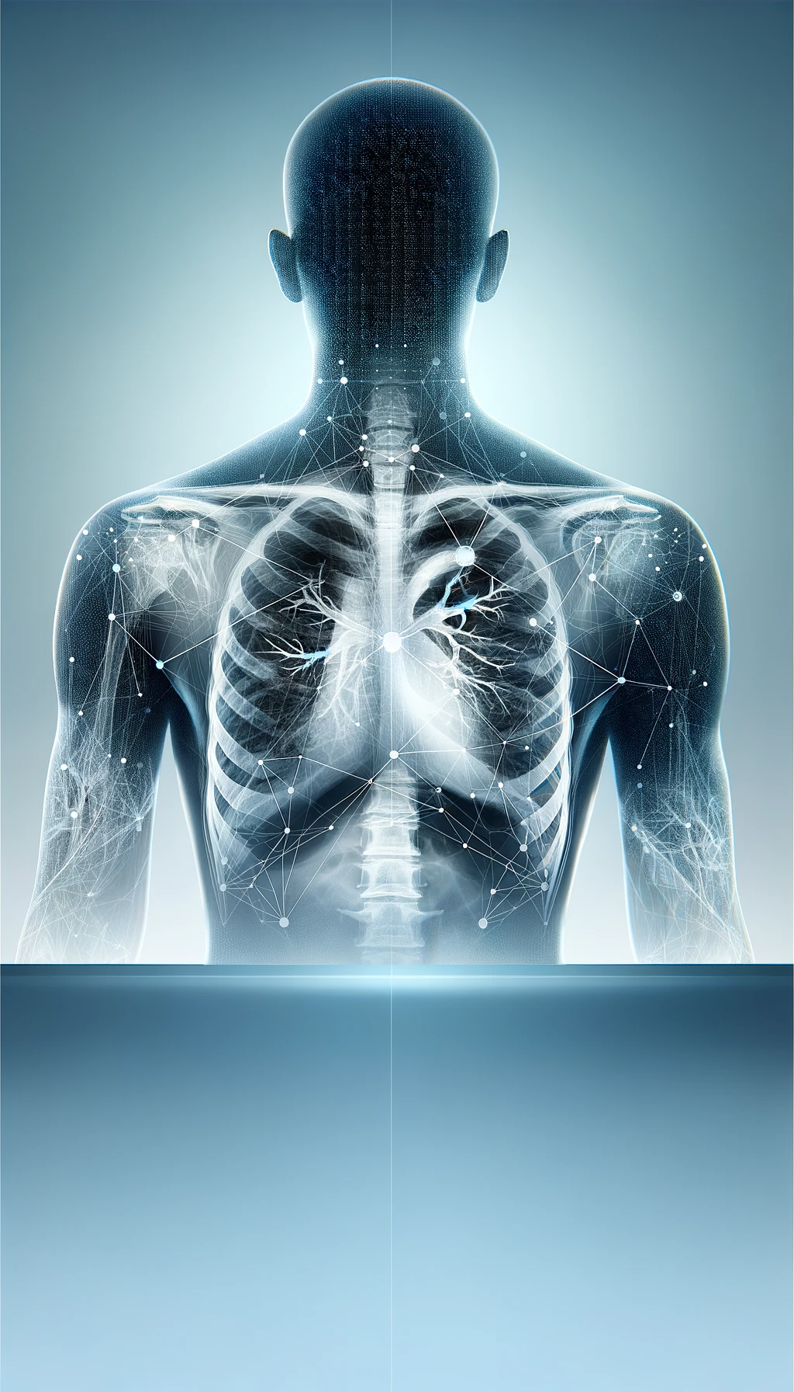
The Problem
Globally, a child dies of pneumonia every 43 seconds.
Pneumonia is the leading cause of morbidity and mortality in children younger than the age of 5, killing more children than HIV/AIDS, malaria, and measles combined.
Chest X-rays are primarily used for the diagnosis of this disease. However, even for a trained radiologist, it is a challenging task to examine chest X-rays.

Slide 3
The Solution - Integrating Deep Learning with Medical Expertise
Deep Learning as a Tool: Deep learning, a key branch of machine learning, is adept at detecting intricate patterns in data. In the medical field, this translates to uncovering subtle indicators in chest X-rays that may elude even seasoned professionals.
Synergy with Medical Practice: The AI system is designed to complement, not replace, medical experts. By expediting diagnosis, it enables timely treatment and contributes to better clinical outcomes
Approach Breakdown:
Simple CNN: Our initial step involves developing a CNN from the ground up, tailored to identify pneumonia in X-rays.
Transfer Learning: We enhance our model's detection capabilities by employing a pre-trained model, leveraging vast pre-existing data patterns.
Fine Tuning: To maximize performance, we fine-tune the model, focusing its learning on the specific task of pneumonia detection.

Slide 4
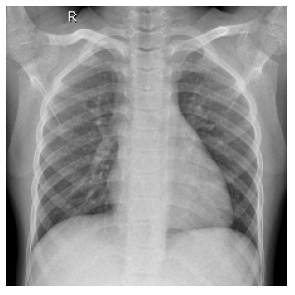
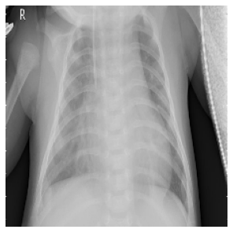
Dataset Overview
Normal X-Ray
The core of our analysis is a dataset consisting of 5,866 pediatric chest X-ray images, each providing a glimpse into the various manifestations of respiratory conditions.
These images have been meticulously collected and verified by the Guangzhou Women and Children’s Medical Center, ensuring a high standard of data quality for our study.
Categorization is critical in medical diagnostics. In this dataset, each image falls into one of two categories: NORMAL, indicating no signs of pneumonia; and PNEUMONIA, where bacterial infection is present; or, where a viral infection is evident.
To facilitate robust model training and evaluation, the dataset is methodically split into subsets: training sets for developing the AI model, and testing sets for assessing its performance and accuracy.
Pneumonia X-Ray

Slide 5
What is Transfer Learning?
Concept Introduction: Transfer Learning is a machine learning technique where a model developed for one task is reused as the starting point for a model on a second task. It's a popular approach in deep learning that can train robust models with comparatively less data.
Significance in Image Classification: In image classification, Transfer Learning allows us to take a pre-trained model that has learned to identify features on a vast dataset and apply it to a specific task. This not only saves significant computational resources but also provides a head start in accuracy and performance.
Core Advantages: This approach is especially beneficial when dealing with limited datasets or when computational power is at a premium. It allows for the leveraging of previously learned patterns, making the development of sophisticated models more accessible.

Slide 6
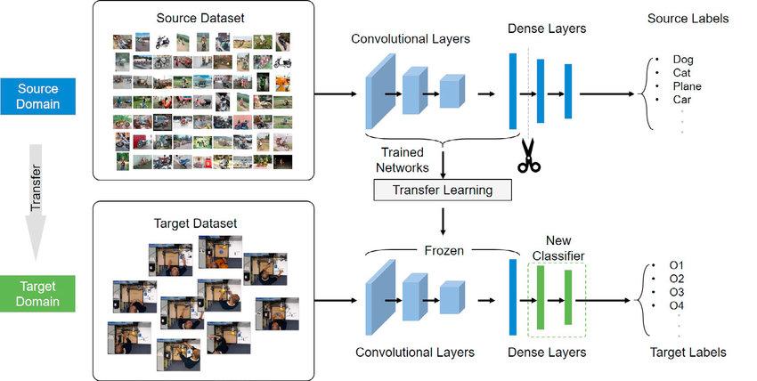
Transfer Learning Example
Image taken from: Real-Time Assembly Operation Recognition with Fog Computing and Transfer Learning for Human-Centered Intelligent Manufacturing - Scientific Figure on ResearchGate.

Slide 7
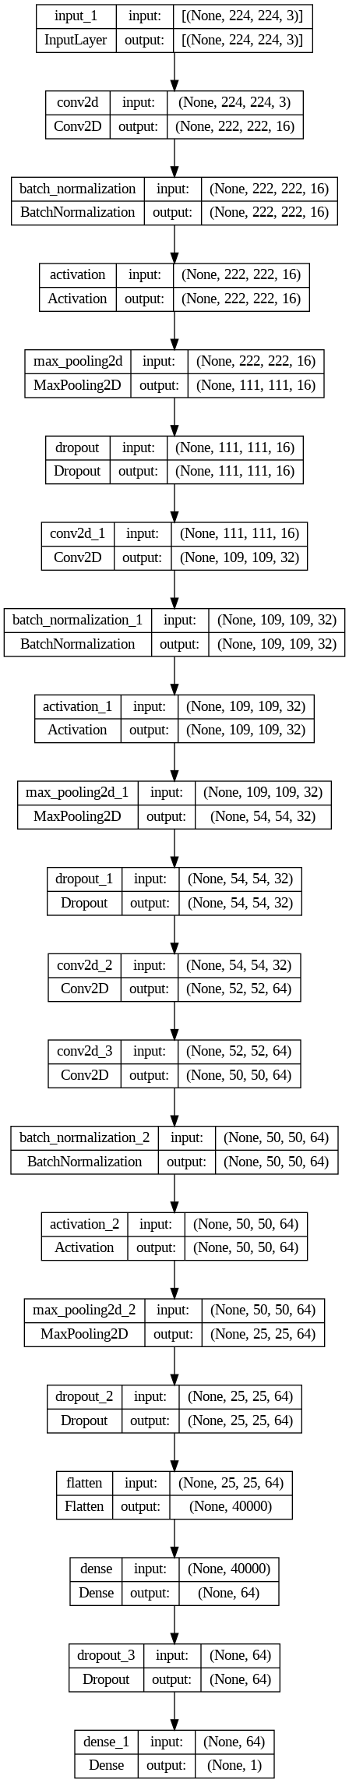
Custom Model for Pneumonia Detection
Simplified schematic of the CNN architecture, showing layers and flow of data processing.
Model Definition:
Our custom CNN model is architecturally designed from the ground up, tailored to the specific textures and patterns found in pneumonia-related chest X-ray images.
It consists of multiple convolutional layers to detect patterns, pooling layers to reduce dimensionality, and fully connected layers for classification.
Training Process:
The model is trained on the pediatric chest X-ray dataset, using a split of data for training and validation. Through this process, it learns to differentiate between normal and pneumonia-afflicted lung images.
Prediction and Evaluation:
Post-training, the model's predictive capabilities are put to the test on unseen data. Evaluation metrics are used to assess the model's performance:
Test loss: 0.355
Test accuracy: 0.854

Slide 8
Pre-trained Model Selection
Choice of ResNet152V2:
We selected the ResNet152V2 model for its deep architecture and remarkable performance on ImageNet, a large visual database designed for use in visual object recognition software research.
ResNet, short for Residual Networks, is a classic neural network used as a backbone for many computer vision tasks due to its 'residual' structure’ that helps in training very deep networks.
Adaptation for Chest X-Rays:
By setting include_top to false, we customized the model by removing the top layer, which is specific to the original ImageNet classes, allowing us to add a classification layer suitable for our chest X-ray images.
This technique enables us to utilize ResNet's powerful feature extraction capabilities while tailoring the final layers to our specific classification needs.
Performance Metrics:
The adapted ResNet152V2 model achieved a test loss of 0.2686 and an impressive accuracy of 90.06% on our dataset, underscoring the efficacy of using pre-trained models in specialized domains.
The success of ResNet152V2 in our project illustrates the power of transfer learning, allowing us to achieve high accuracy with less computational time and resources compared to training a model from scratch.

Slide 9
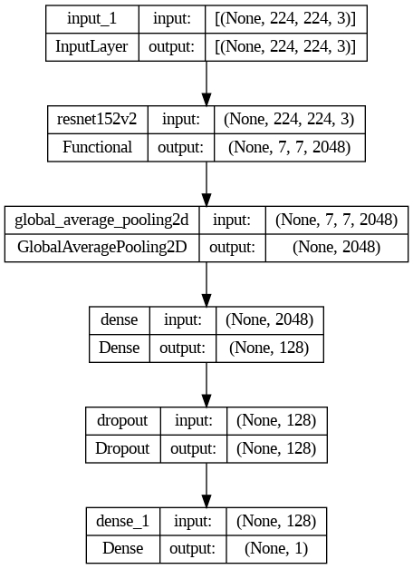
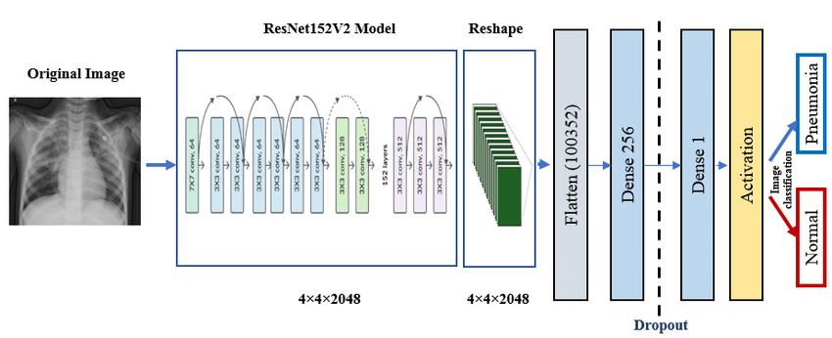
ResNet152V2 Architecture
Customized ResNet architecture, highlighting the depth and flow of layers.
Image taken from: Deep-Pneumonia Framework Using Deep Learning Models Based on Chest X-Ray Images - Scientific Figure on ResearchGate.

Slide 10
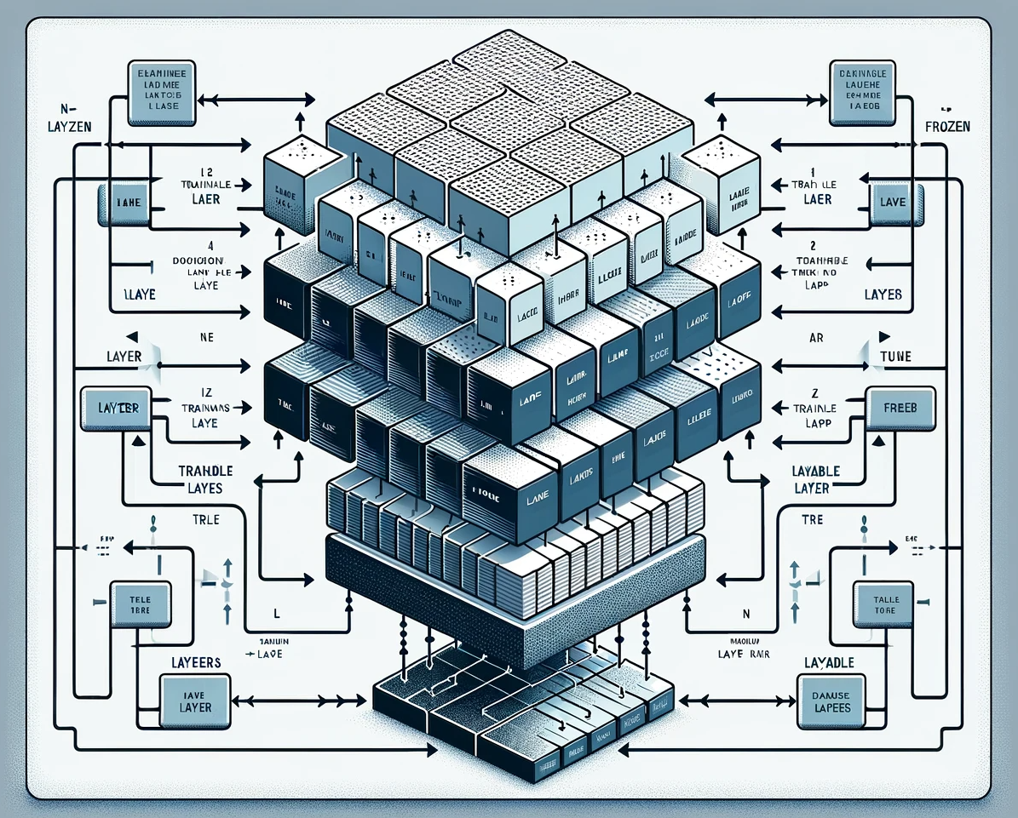
Fine-Tuning the ResNet Model
Strategic Layer Training:
For fine-tuning, we unlocked the last 13 layers of the ResNet152V2 model, allowing these layers to be trained with our dataset. This strategy keeps the pre-learned weights intact while adapting the most sophisticated features to our specific task.
Preserving Core Knowledge:
The remaining layers are kept frozen to preserve the rich feature extraction capabilities developed through the original ImageNet training, ensuring that the model retains its generalizable knowledge.
Controlled Learning Rate:
A low learning rate is employed to ensure that updates to the model weights are small and precise, preventing the overwriting of the nuanced features that the model has already learned.
Enhanced Performance Metrics:
This fine-tuning approach resulted in a reduced test loss of 0.2351 and increased the accuracy to 90.54%, demonstrating the effectiveness of the fine-tuning process.
Infographics illustrating a ResNet neural network with ‘frozen’ and ‘unfrozen’ layers

Slide 11
Comparing Results - Transfer Learning vs. Custom Model
Loss and Accuracy Curves:
The fine-tuned model shows rapid convergence, as seen in the loss curves, with a stable decrease in validation loss indicating good generalization.
Compared to the simple CNN, the fine-tuned model has less overfitting, with a smoother validation loss curve.
Validation Accuracy:
In terms of validation accuracy, the fine-tuned model not only surpasses the simple CNN but also demonstrates greater stability over epochs, a sign of its robustness in medical image classification.
Overall Performance:
The fine-tuned model achieves superior performance with a higher accuracy rate and a significant reduction in loss compared to both the simple CNN and the pre-trained model without fine-tuning.
These comparative results clearly illustrate the advantage of fine-tuning in clinical image analysis, with the fine-tuned ResNet152V2 model offering a more accurate and reliable tool for pneumonia detection in chest X-rays.

Slide 12
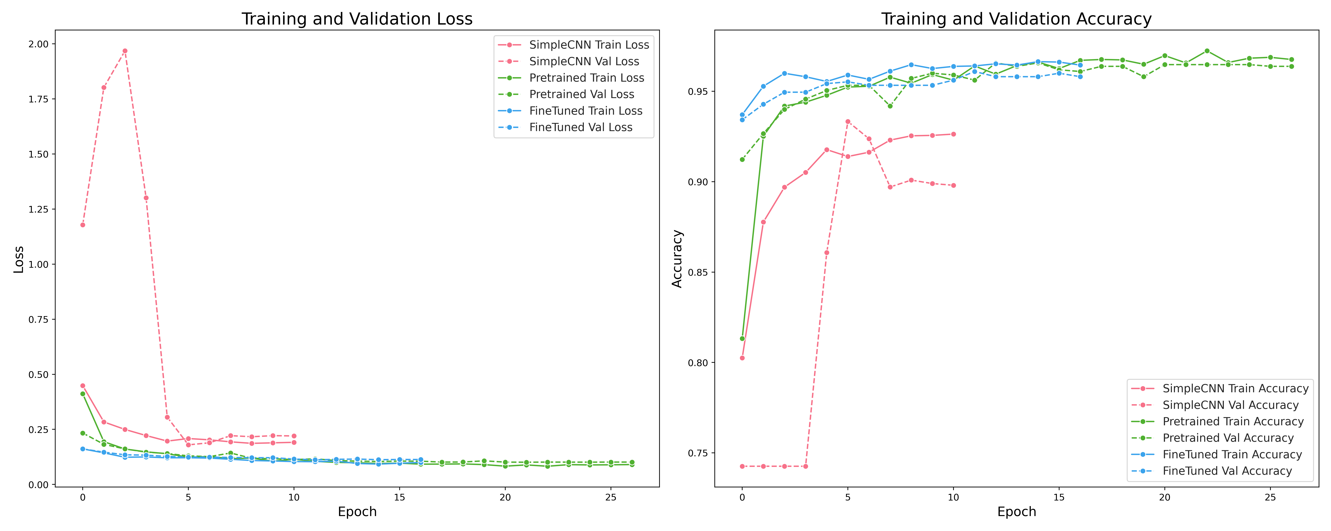
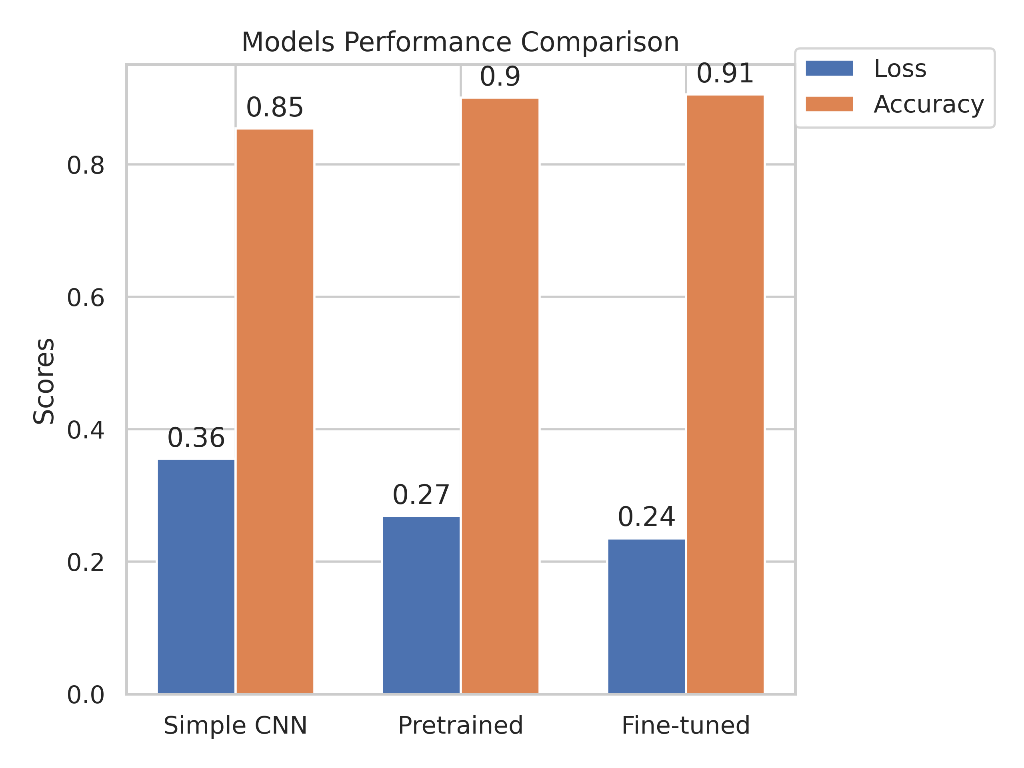
The graph analysis reveals that the fine-tuned model converges more rapidly and with less overfitting than the simple CNN model.
The fine-tuned model exhibits higher stability in validation accuracy across epochs, suggesting a robust response to medical imaging tasks.
Overall, the fine-tuned model demonstrates superior performance with a significant reduction in loss and an increase in accuracy, validating the benefits of fine-tuning in clinical image analysis.
The displayed trends underscore the practical advantage of employing advanced transfer learning techniques in the development of medical diagnostic tools.

Slide 13
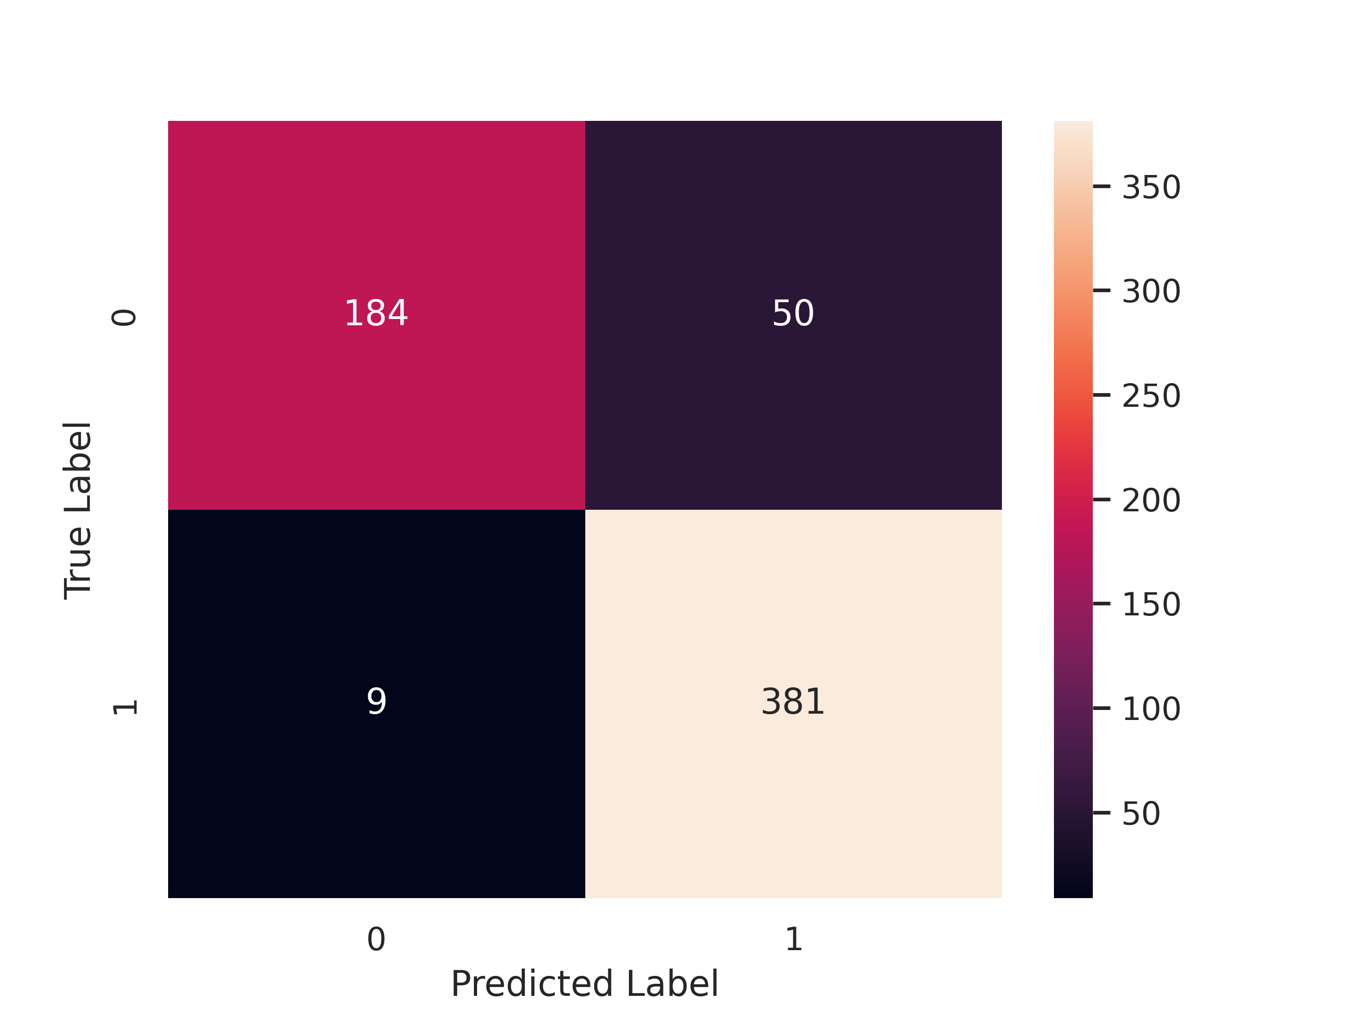
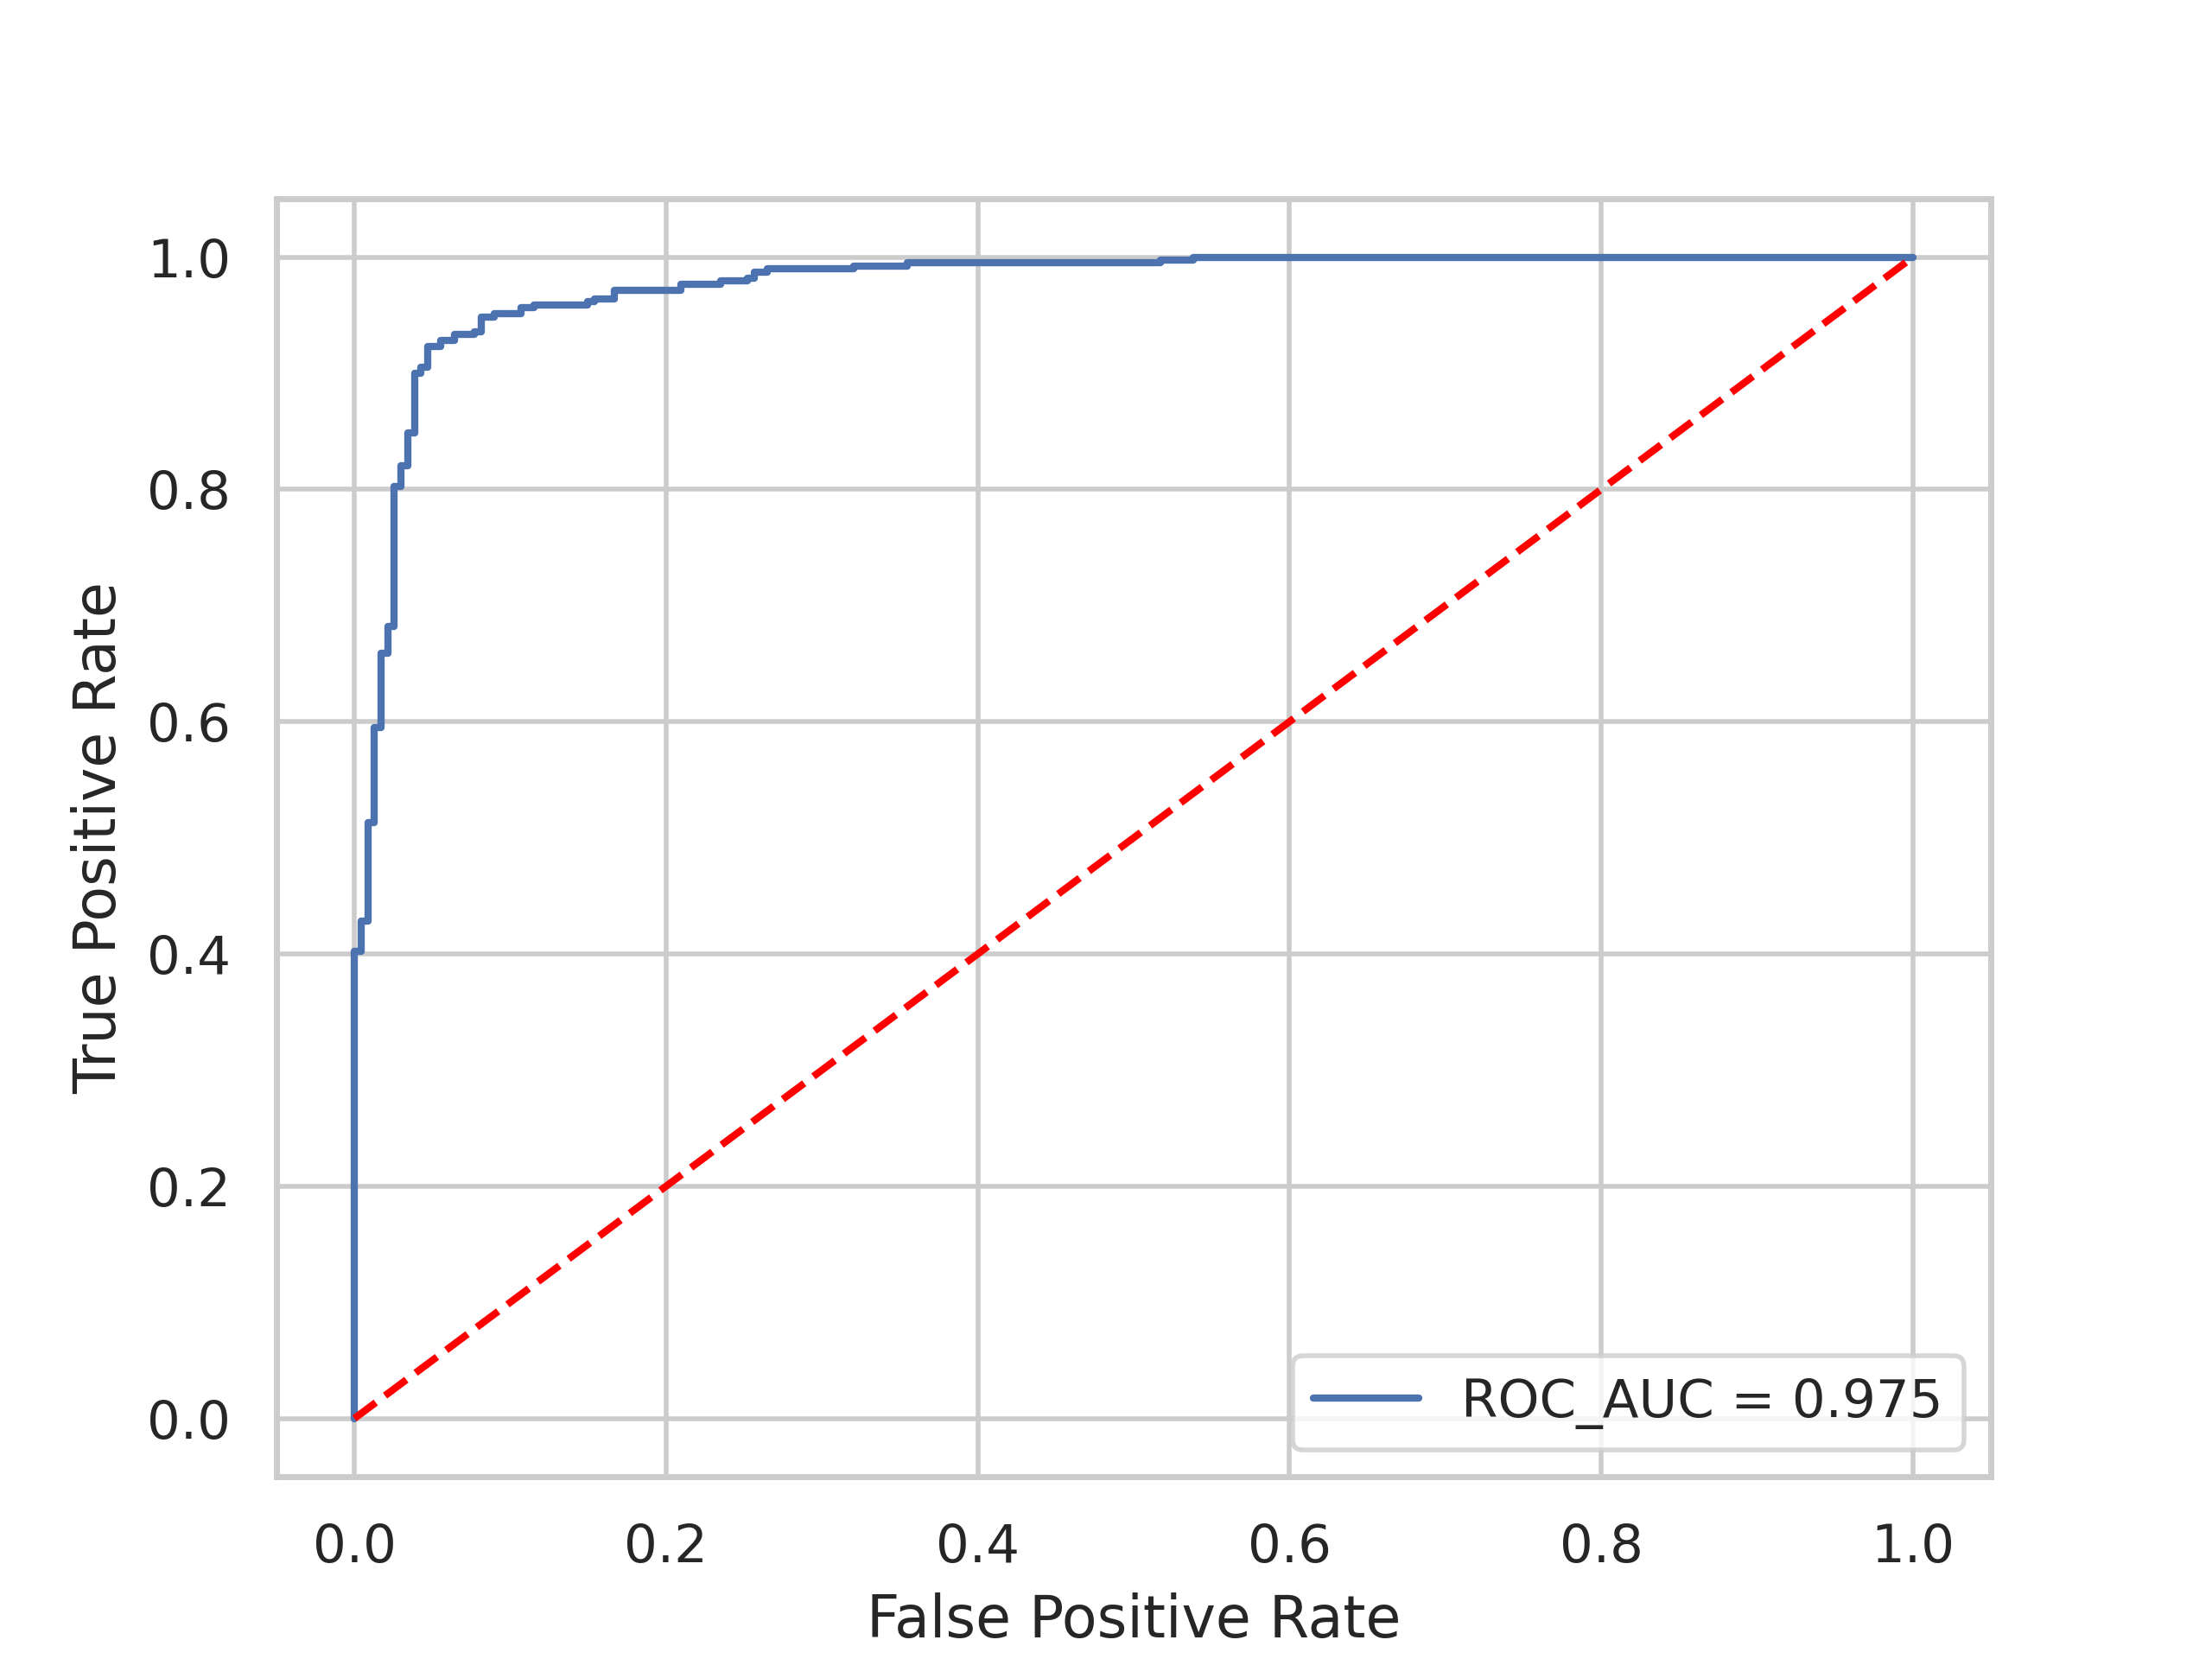
Evaluating Model Reliability Through Performance Metrics
Confusion Matrix
Confusion Matrix Analysis:
The confusion matrix shows a high number of true positives (381) and true negatives (184), indicating strong model reliability.
With only 9 false negatives, the model demonstrates a high recall rate, which is critical in medical diagnostics to minimize the risk of missing a true pneumonia case.
Classification Report
Classification Report:
The model achieves a high precision (0.95 for 'Normal' and 0.88 for 'Pneumonia'), and an even higher recall (0.79 for 'Normal' and 0.98 for 'Pneumonia'), resulting in a balanced F1-score (0.86 and 0.93, respectively).
Overall accuracy stands at 0.91, with macro and weighted averages above 0.89, reflecting consistent performance across classes
Metric | Class Normal | Class Pneumonia | Overall
Precision | 0.95 | 0.88 | 0.91
Recall | 0.79 | 0.98 | 0.91
F1-Score | 0.86 | 0.93 | 0.90
Support | 234 | 390 | 624
ROC Curve and AUC:
The ROC curve is well above the diagonal, with an AUC of 0.975, signifying the model's excellent capability to differentiate between the 'Normal' and 'Pneumonia' classes.
The model's balance of high recall, precision, and a strong ROC-AUC score underscores its potential utility in clinical settings, where the cost of misdiagnosis is high. Its performance is particularly notable given the limited training data, emphasizing the efficiency of the learning algorithm.
ROC curve

Slide 14
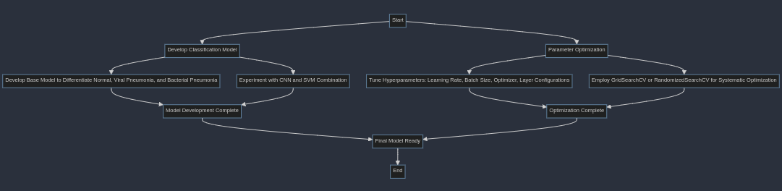
Limitations and Potential Improvements
Current Limitations:
While the current model provides high accuracy, it is primarily binary, distinguishing between normal and pneumonia cases. It does not differentiate between viral and bacterial pneumonia.
The current CNN architecture is stand alone and may benefit from ensemble methods that integrate multiple classifiers for enhanced performance.
Proposed Future Enhancements:
Develop a multi-class classification model that can accurately differentiate between normal, viral pneumonia, and bacterial pneumonia.
Experiment with combining CNN models with other classifiers, like Support Vector Machines (SVM), to leverage the strengths of various learning algorithms.
Parameter Optimization:
Further tuning of hyper parameters, including learning rate, batch size, optimizer, and layer configurations, can potentially lead to performance gains.
Employ advanced techniques like GridSearchCV or RandomizedSearchCV to systematically search for the best parameter configurations.
Flowchart outlining the proposed enhancement steps

Slide 15
Conclusion and Ethical Implications
Project Summary:
The project successfully developed a machine learning model using transfer learning to classify chest X-rays for pneumonia detection with high accuracy and reliability.
Preventative Recommendations:
Pneumonia prevention is crucial, especially in vulnerable age groups. Addressing factors like overcrowding, clean water access, and environmental pollutants is essential for reducing pneumonia risk.
Data Collection Investment:
Investment in systematic data collection, particularly in under-resourced regions, is recommended to improve disease understanding and model training.
Diagnostic Standards Development:
There's a need for a universally accepted diagnostic standard for childhood pneumonia, one that differentiates between bacterial and non-bacterial types to inform treatment strategies.
Ethical Considerations:
Ethically, the use of transfer learning in medical image classification raises questions about data privacy, consent, and the need for transparent, bias-free models.
It also presents an opportunity to improve diagnostic accuracy, reduce healthcare costs, and make quality healthcare more accessible.
The findings of this project support the potential of AI to enhance medical diagnostics. However, they also highlight the necessity for ethical guidelines to ensure equitable and safe implementation.

Slide 16
References
Bourke, M. (n.d.). Convolutional Neural Networks in TensorFlow. Retrieved from GitHub Repository
Chang, A. B., Ooi, M. H., Perera, D., & Grimwood, K. (2013). Improving the Diagnosis, Management, and Outcomes of Children with Pneumonia: Where are the Gaps?. Frontiers in pediatrics, 1, 29. https://doi.org/10.3389/fped.2013.00029
Geron, A. (2019). Hands-on machine learning with Scikit-Learn, Keras and TensorFlow: concepts, tools, and techniques to build intelligent systems (2nd ed.). O’Reilly.
Keras. (n.d.). Applications. Retrieved from Keras Applications
Keras. (n.d.). ResNet152V2 function. Retrieved from Keras API
Kermany, D. S., Goldbaum, M., Cai, W., et al. (2018). Identifying Medical Diagnoses and Treatable Diseases by Image-Based Deep Learning. Cell, 172(5), 1122–1131.e9. https://doi.org/10.1016/j.cell.2018.02.010
ResearchGate. (n.d.). Deep Pneumonia Framework Using Deep Learning Models Based on Chest X-Ray Images. Retrieved from ResearchGate Publication
TensorFlow. (n.d.). ImageDataGenerator. Retrieved from TensorFlow API Docs
TensorFlow. (n.d.). Transfer learning and fine-tuning. Retrieved from TensorFlow Guide
Unicef. (2021, April 07). Pneumonia in children statistics. Retrieved April 13, 2021, from https://data.unicef.org/topic/child-health/pneumonia
Vijayabhaskar, J. (n.d.). Tutorial on keras flow from dataframe. Retrieved from Medium Tutorial

